Slide 1
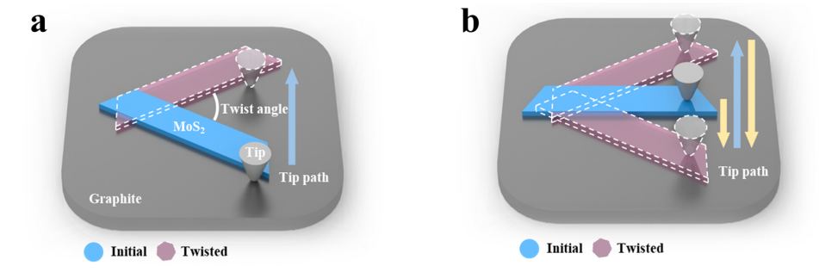
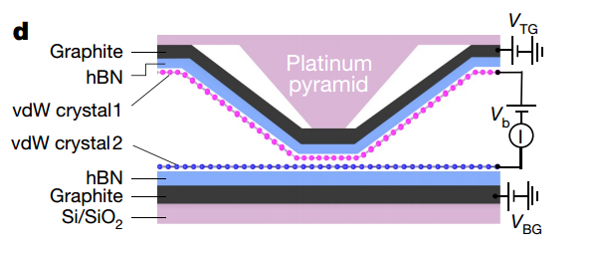
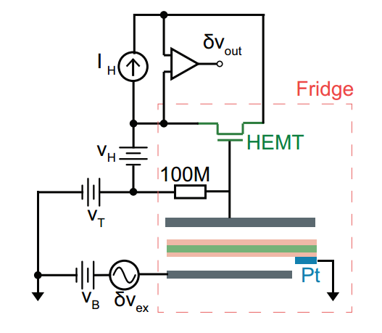
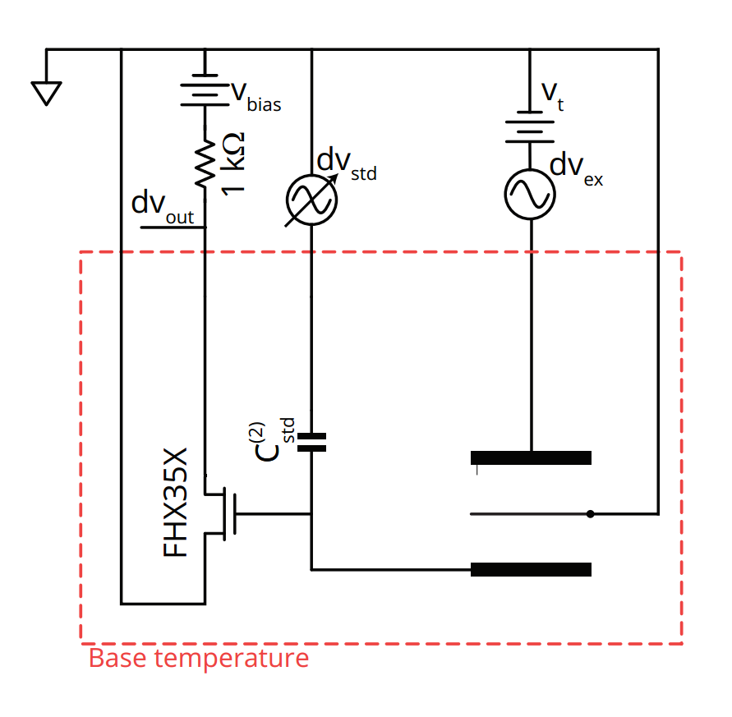
工作进展与计划
1、读文献
* Twisting Dynamics of Large Lattice-Mismatch van der Waals Heterostructures
* The quantum twisting microscope
* Odd- and even-denominator fractional quantum Hall states in monolayer WSe2
* Even-denominator fractional quantum Hall states at an isospin transition in monolayer graphene
* Tunable interacting composite fermion phases in a half-filled bilayer-graphene Landau level
….
2、AFM扫摩尔纹
样品是MLG/BN，未扫出摩尔纹。
3、撕材料找材料
BN、BLG、WSe2
4、接线盒组装
目前组装了一部分，导通测试正常。
下周计划
1、stack电容制备、测试
2、Dynamic Heterostructure实验
3、接线盒焊接组装

Slide 2
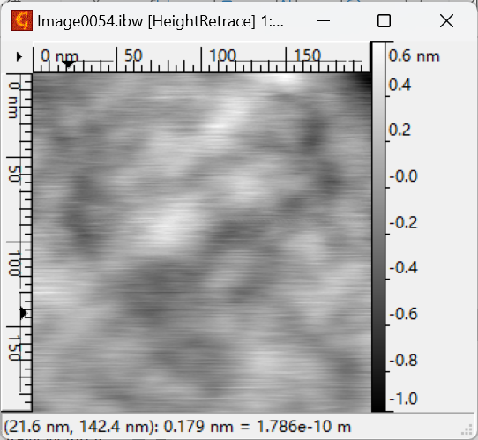
工作进展与计划
1、读文献
* Twisting Dynamics of Large Lattice-Mismatch van der Waals Heterostructures
* The quantum twisting microscope
* Odd- and even-denominator fractional quantum Hall states in monolayer WSe2
* Even-denominator fractional quantum Hall states at an isospin transition in monolayer graphene
* Tunable interacting composite fermion phases in a half-filled bilayer-graphene Landau level
….
2、AFM扫摩尔纹
样品是MLG/BN，未扫出摩尔纹。
3、撕材料找材料
BN、BLG、WSe2
4、接线盒组装
目前组装了一部分，导通测试正常。
下周计划
1、stack电容制备、测试
2、Dynamic Heterostructure实验
3、接线盒焊接组装

Slide 3
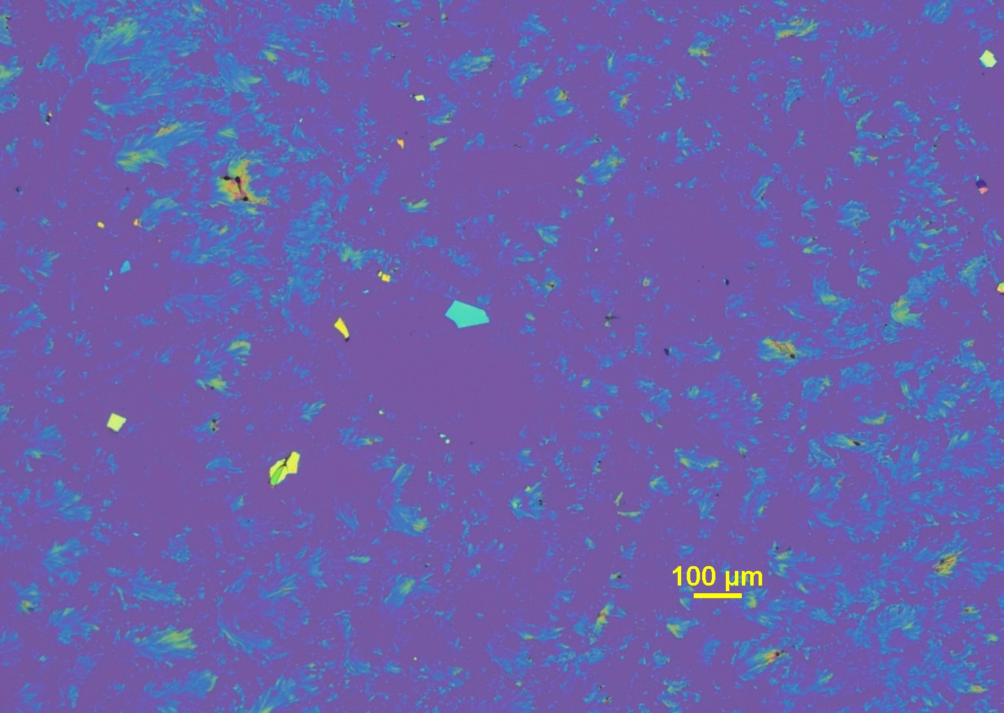
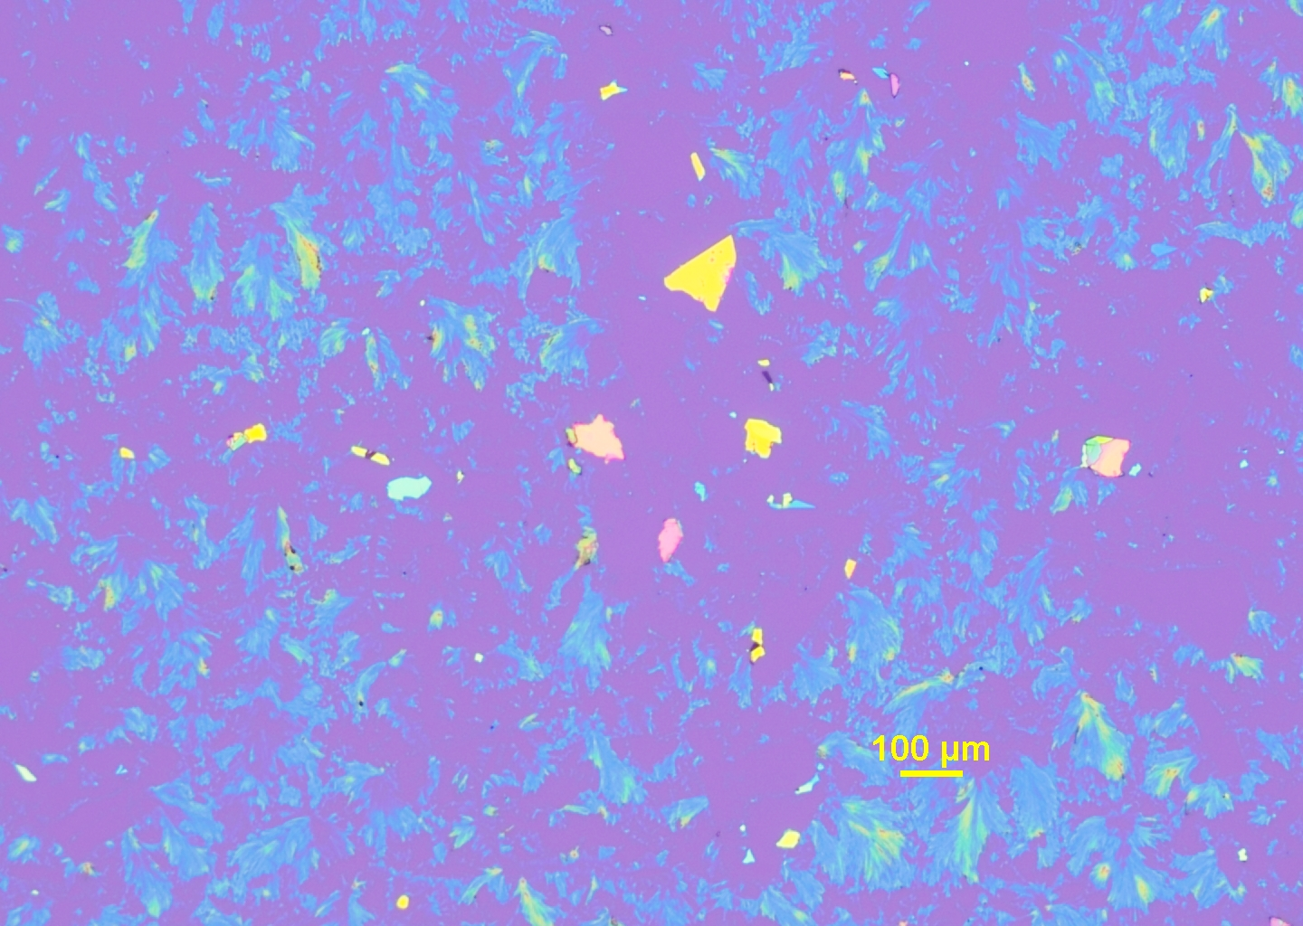
工作进展与计划
1、读文献
* Twisting Dynamics of Large Lattice-Mismatch van der Waals Heterostructures
* The quantum twisting microscope
* Odd- and even-denominator fractional quantum Hall states in monolayer WSe2
* Even-denominator fractional quantum Hall states at an isospin transition in monolayer graphene
* Tunable interacting composite fermion phases in a half-filled bilayer-graphene Landau level
….
2、AFM扫摩尔纹
样品是MLG/BN，未扫出摩尔纹。
3、撕材料找材料
BN、BLG、WSe2
4、接线盒组装
目前组装了一部分，导通测试正常。
下周计划
1、stack电容制备、测试
2、Dynamic Heterostructure实验
3、接线盒焊接组装

Slide 4
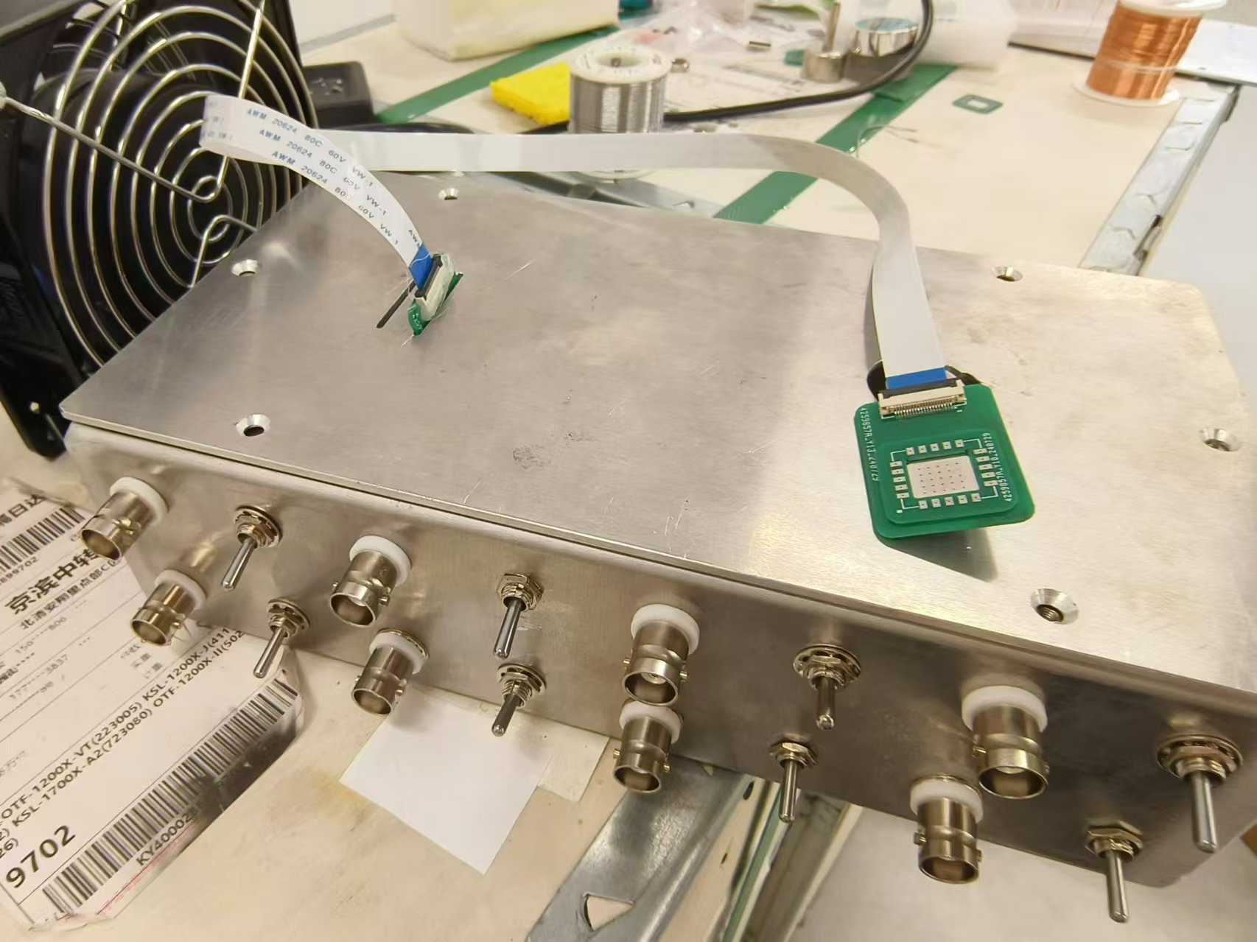
工作进展与计划
1、读文献
* Twisting Dynamics of Large Lattice-Mismatch van der Waals Heterostructures
* The quantum twisting microscope
* Odd- and even-denominator fractional quantum Hall states in monolayer WSe2
* Even-denominator fractional quantum Hall states at an isospin transition in monolayer graphene
* Tunable interacting composite fermion phases in a half-filled bilayer-graphene Landau level
….
2、AFM扫摩尔纹
样品是MLG/BN，未扫出摩尔纹。
3、撕材料找材料
BN、BLG、WSe2
4、接线盒组装
目前组装了一部分，导通测试正常。
下周计划
1、stack电容制备、测试
2、Dynamic Heterostructure实验
3、接线盒焊接组装

Slide 5
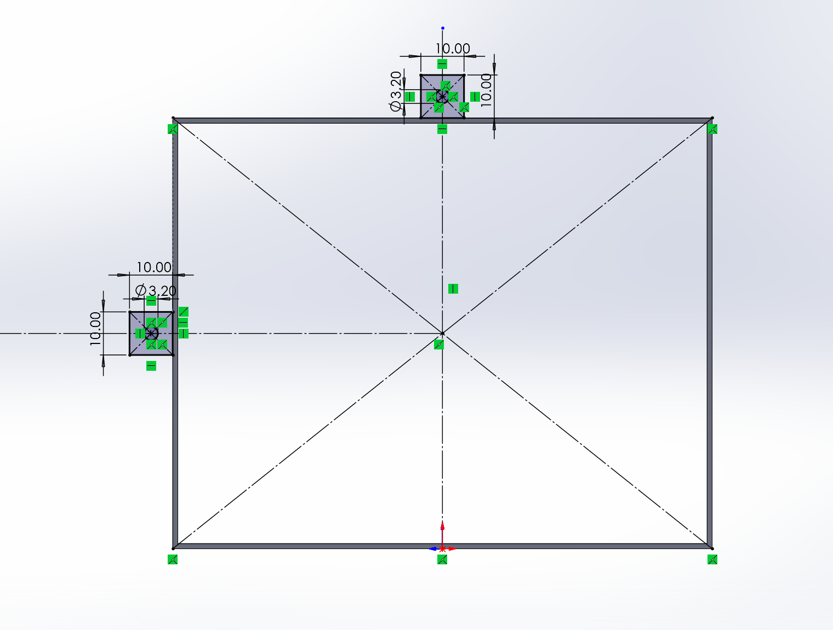
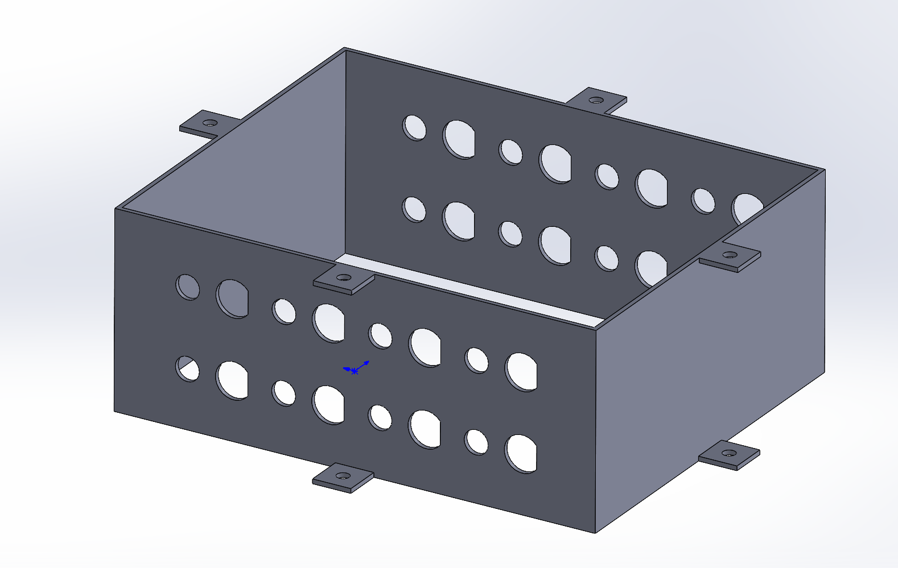

Slide 6
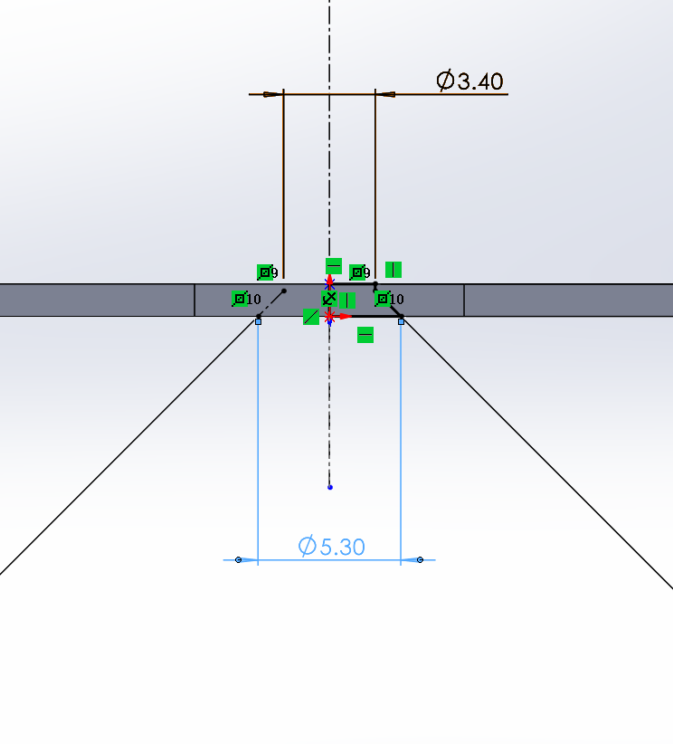
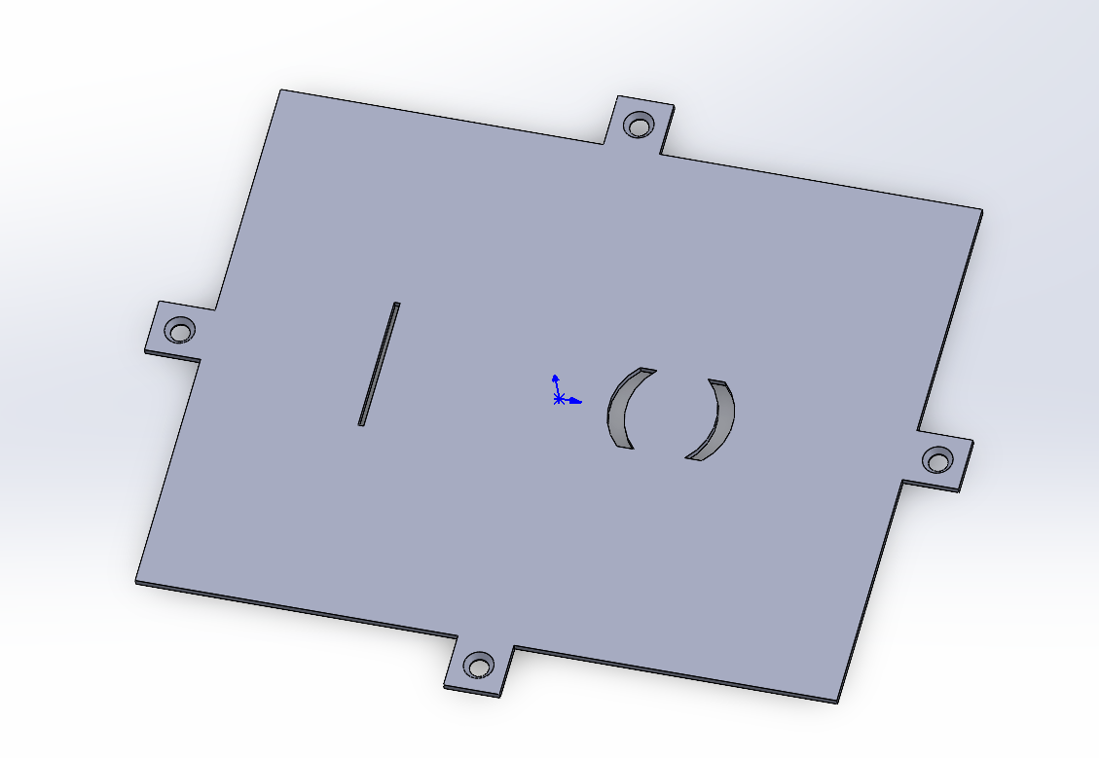

Slide 7
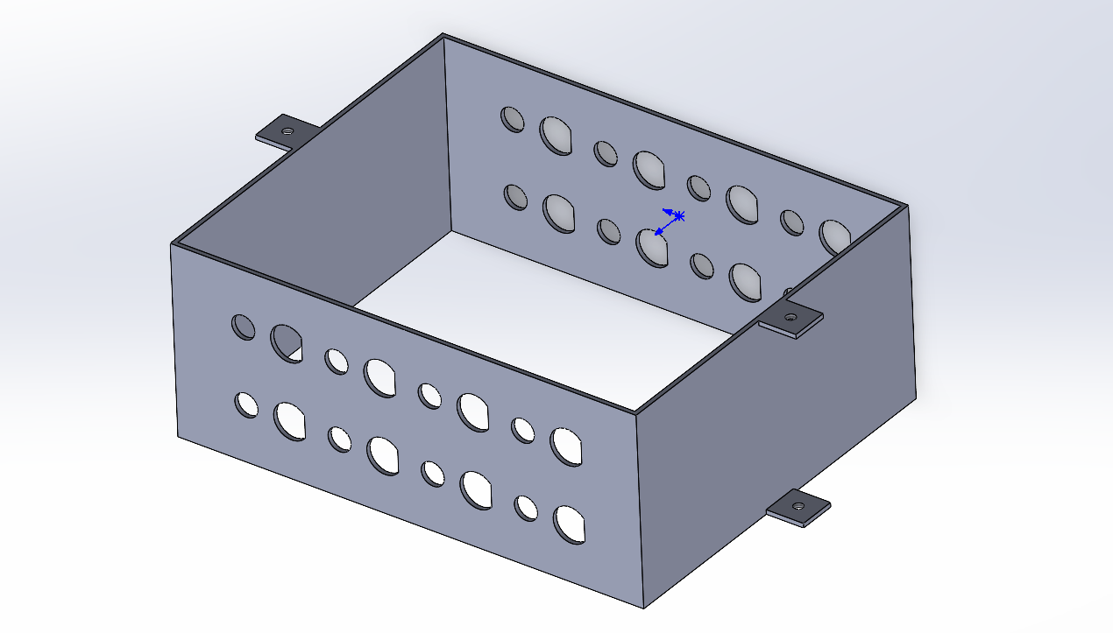

Slide 9
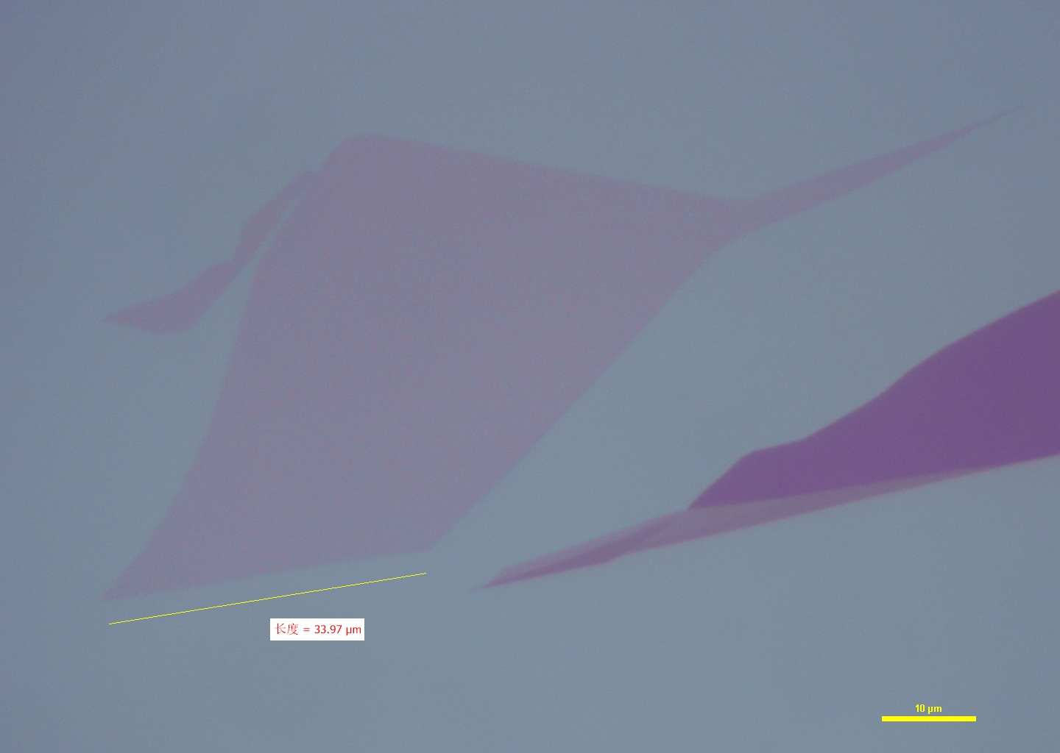
chip6 14 100x
150°

Slide 10
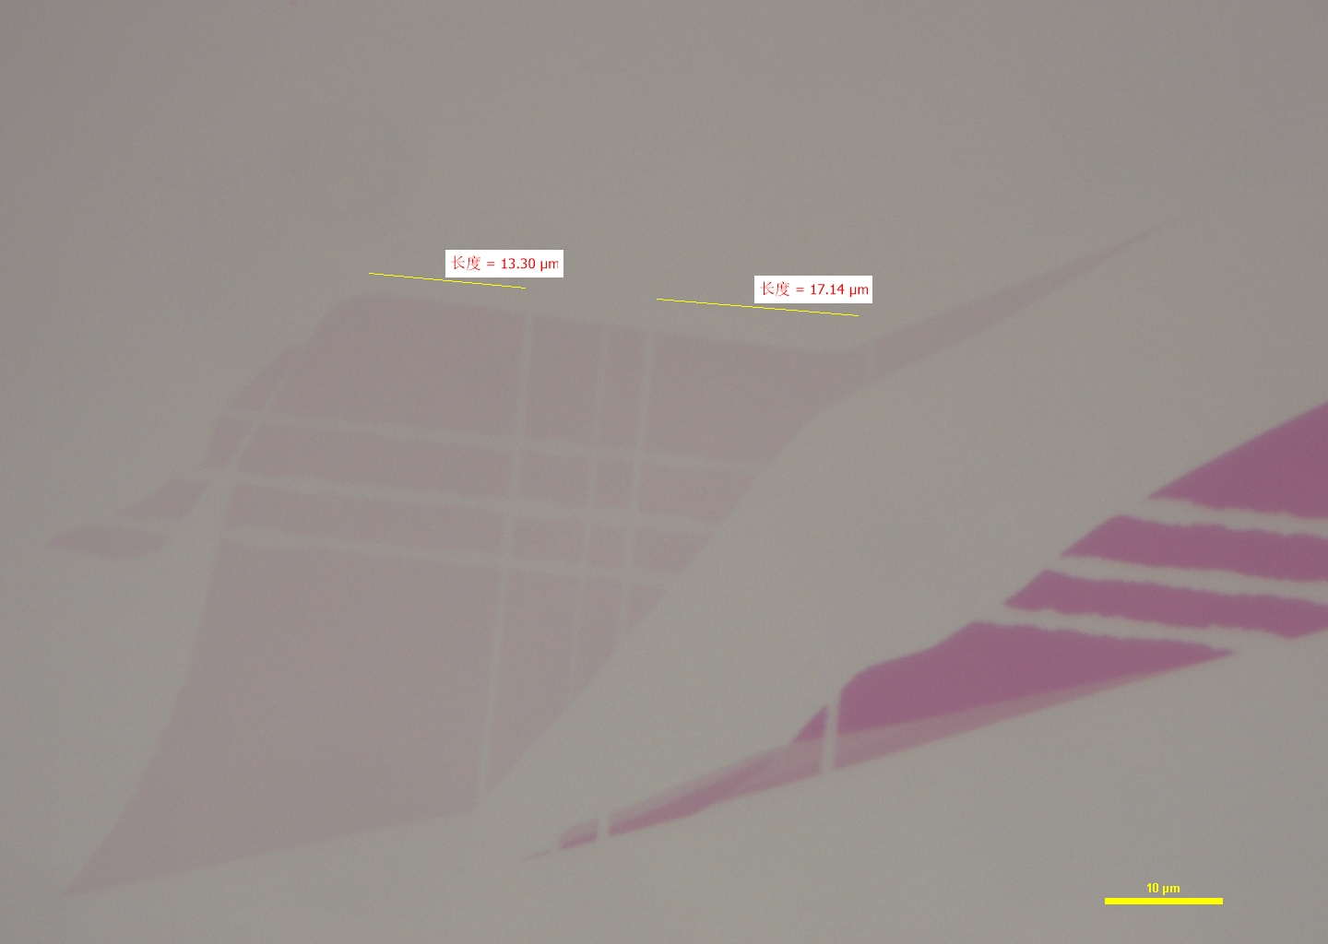
① 0°
② 30°

Slide 11
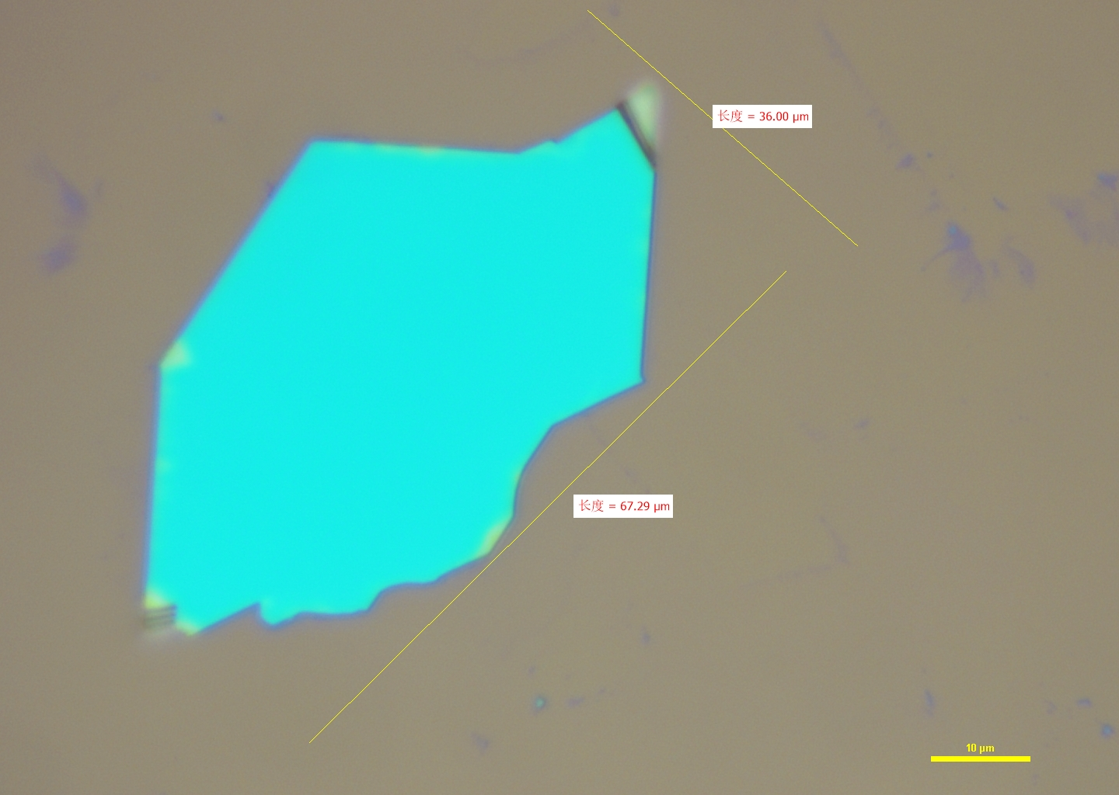

Slide 12
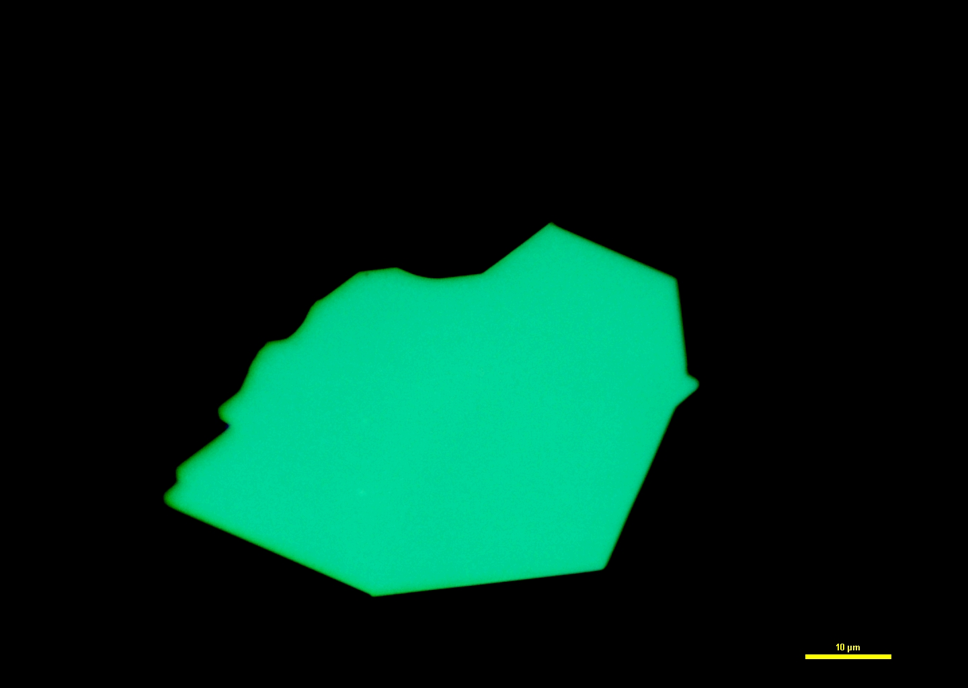
Pick up BN

Slide 13
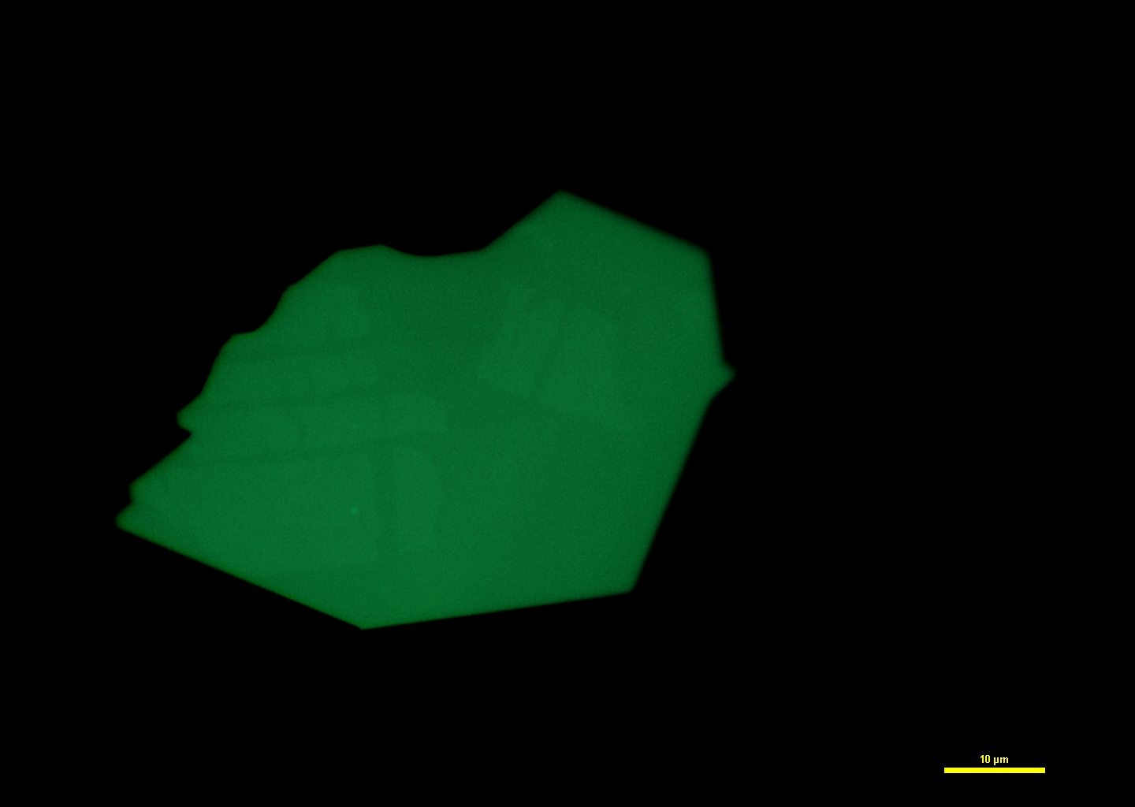
Pick up Gr
半高全宽26
27~28°
半高全宽20
1~2°

Slide 14
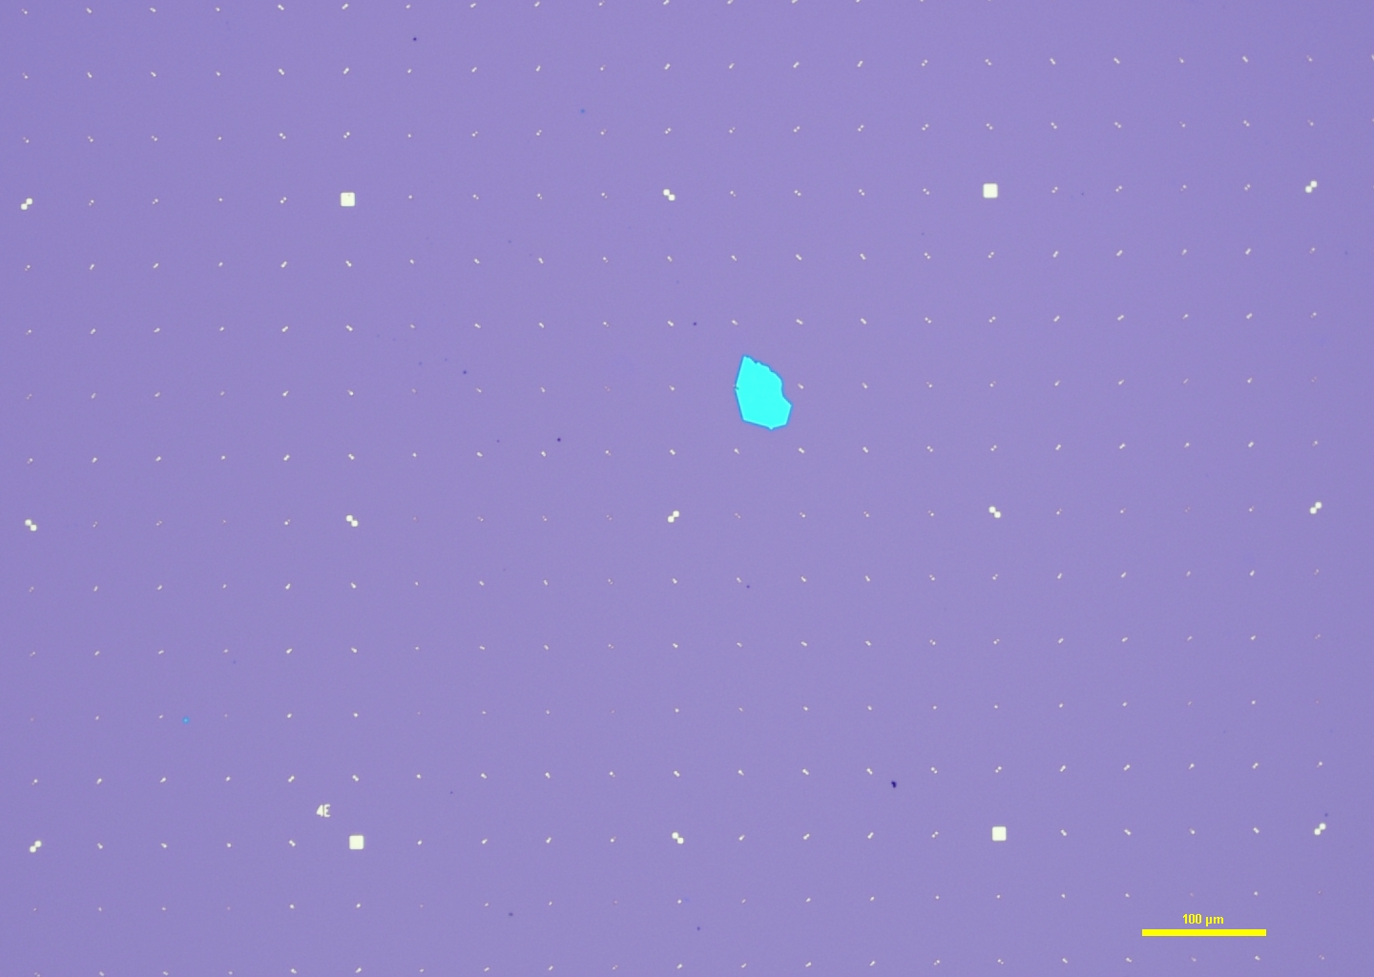
4E 附近 10x

Slide 15
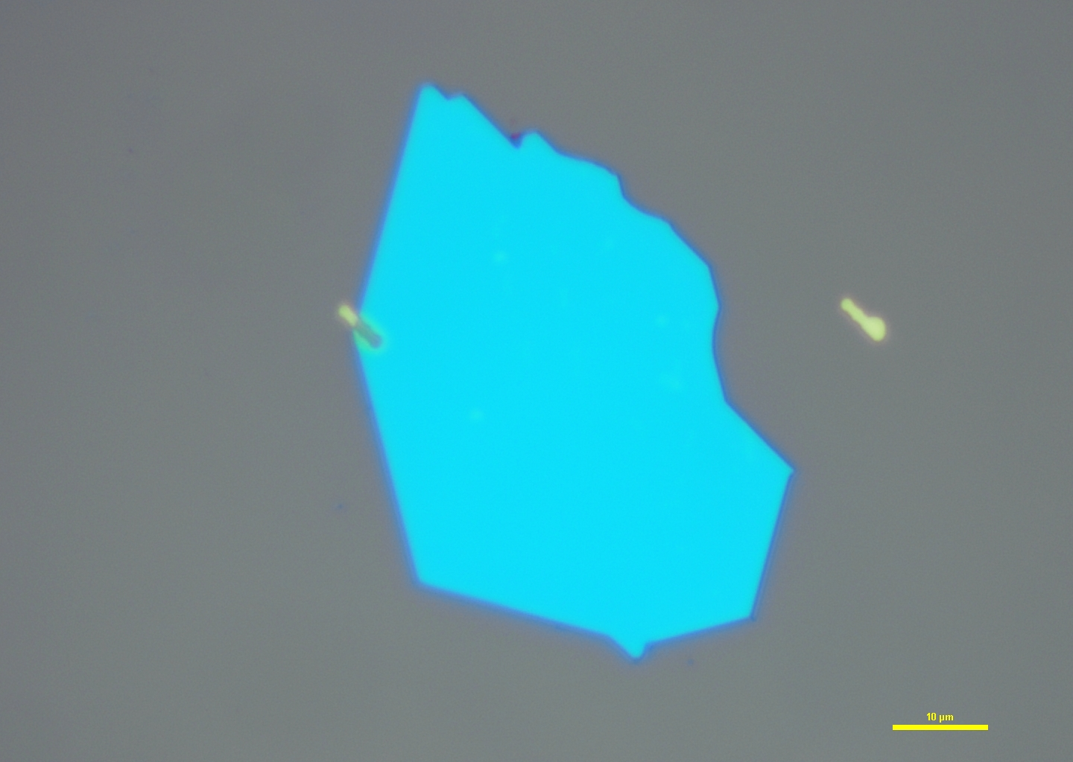
4E 附近 100x

